Slide 1

Brenda’s Glass Expression
PROJECT Proposal
Josmi Jose DGL 113 2023 CVS2

Slide 2

The Client : Brenda’s Glass Expression
Brenda's Glass Expression is a family-owned business in Comox Valley, Northern Vancouver Island.
It provides glass working equipment and materials.
It also offers stained glass repairs and stained-glass art.
It is established and successful for sixteen years.

Slide 3
Project Proposal
Home Page
Popup message
While popups can be effective in grabbing users, onload of home page loads small pop-up that can be easily dismissed which communicate the promo or discount to the user.
Image popout
Increasing the height and width of images on the home page and adding a mouse enter event.

Slide 4
Project Proposal
News Page
Add news dynamically
By including an add icon, users will be able to add news to the news page and have it appear in the news sections.

Slide 5
Project Proposal
Our Services Page
On-hover effect
By including an on-hover effect to the button, the user is made aware that when they click the services button on the service page, they may view detailed services.

Slide 6
Project Proposal
Contact Us Page
Submit Button validation
Make sure that the contact page form's mandatory fields are accurately filled out by adding a validation feature. Also, additional text boxes for the phone number and email address should be added, and proper regex validation should be used to guarantee that the input is in the right format.
Reset button confirm popup
Users who want to reset all the fields at once may find it useful if a reset button is included on the contact us page. I also think about including a confirmation dialogue box to prevent unintentional clicks.

Slide 7
Html Validation
W3C Markup Validation Service, which is a tool that allows you to validate the markup (HTML, XHTML, etc.) of a web page to ensure that it follows the rules of the language and is free from errors.
To use the tool, you would need to upload the HTML file you want to validate or enter the URL of the web page you want to check, and then click the "Check" button. The tool will then analyze the code and provide a report of any errors or warnings that it finds.

Slide 8
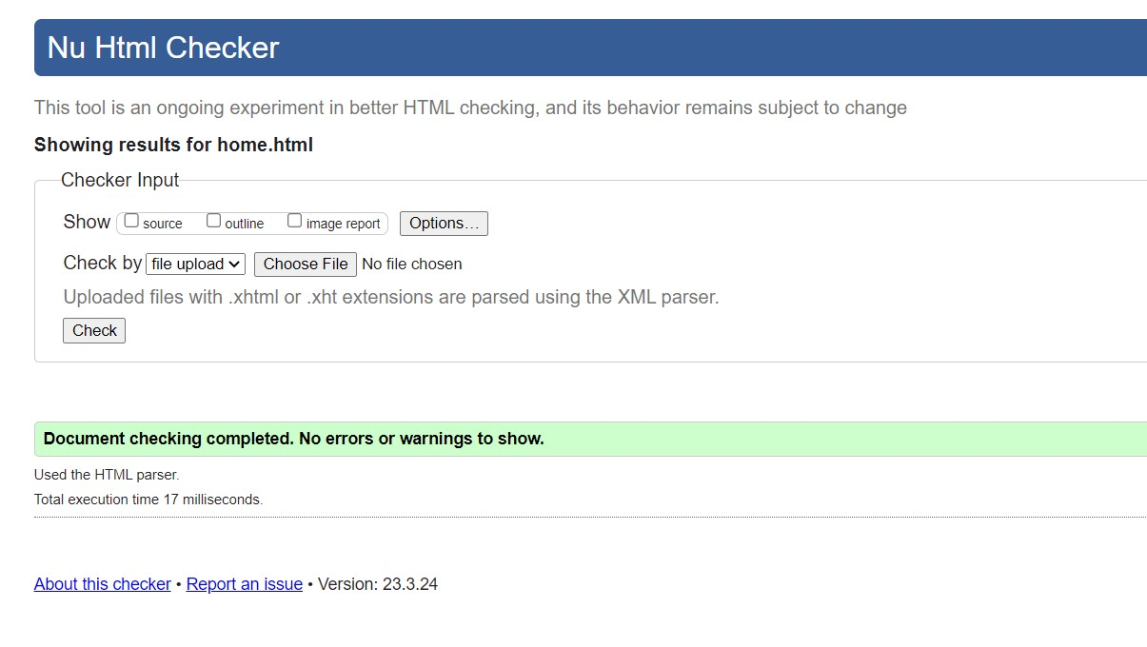
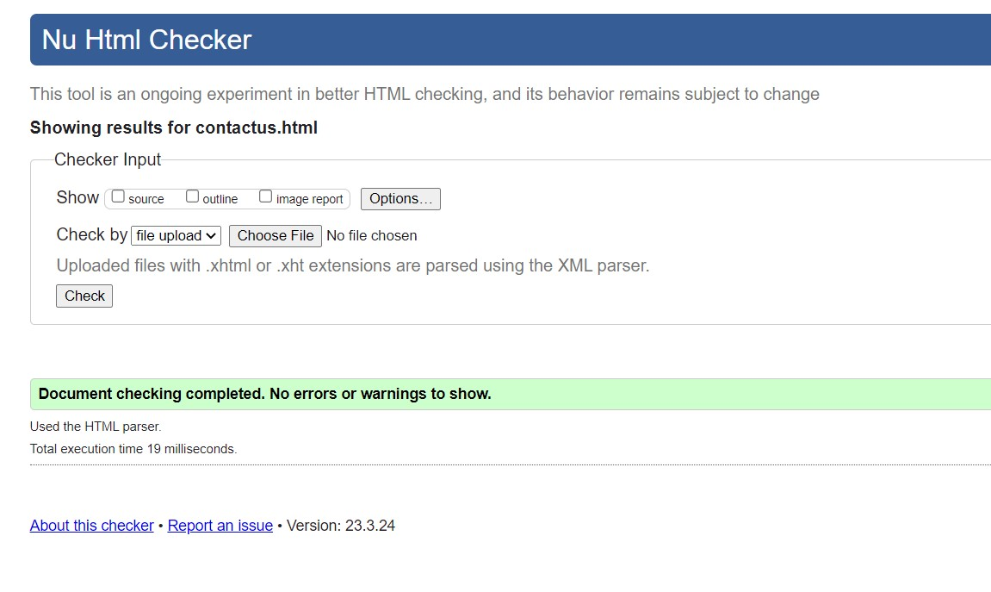
Html Validation

Slide 9
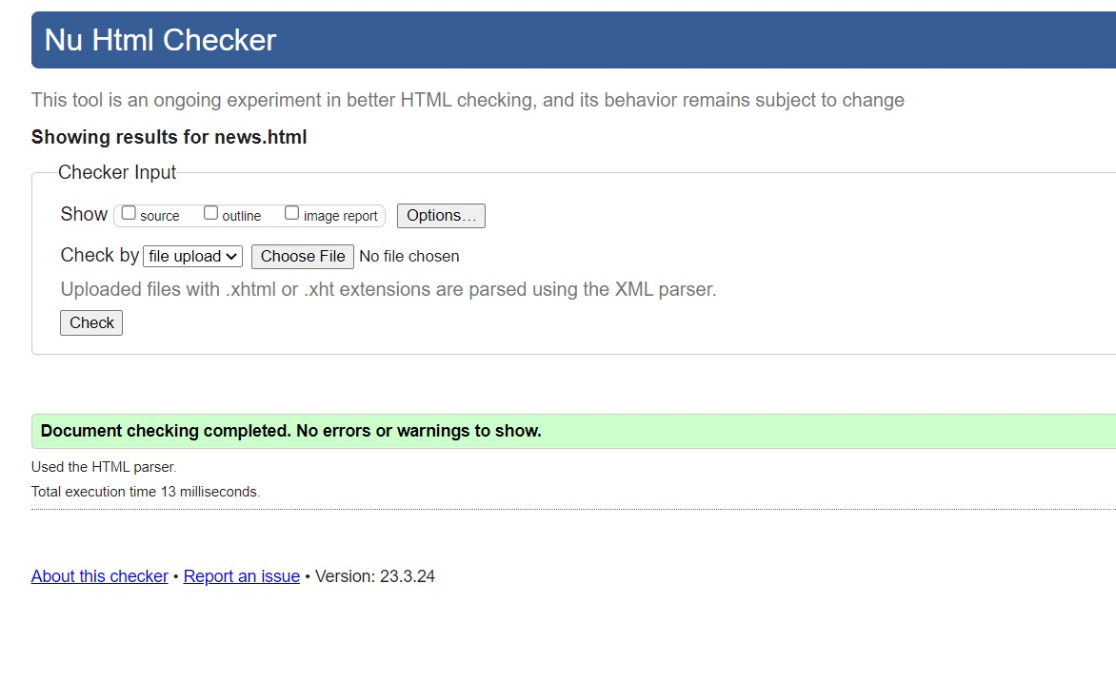
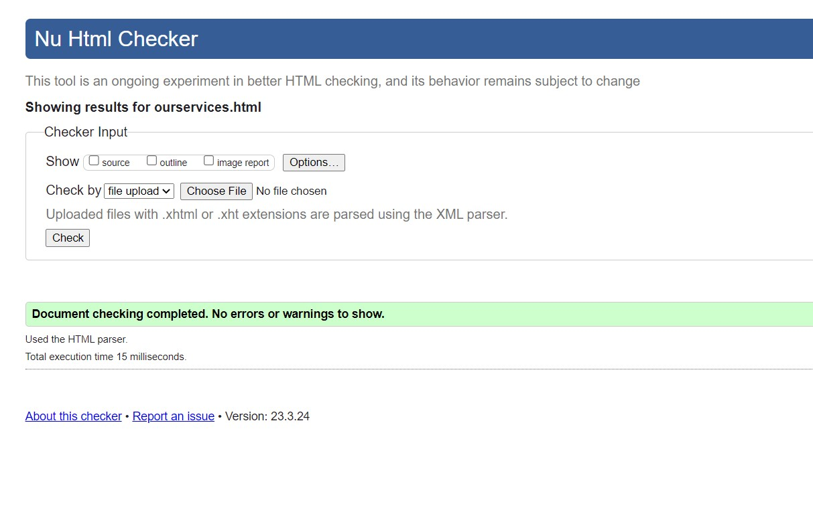
Html Validation

Slide 10
CSS Validation
W3C CSS Validation Service, which is a tool that allows you to validate the CSS code of a web page to ensure that it follows the rules of the language and is free from errors.
To use the tool, you would need to enter the URL of the web page you want to check, or upload the CSS file you want to validate, and then click the "Check" button. The tool will then analyze the code and provide a report of any errors or warnings that it finds.

Slide 11
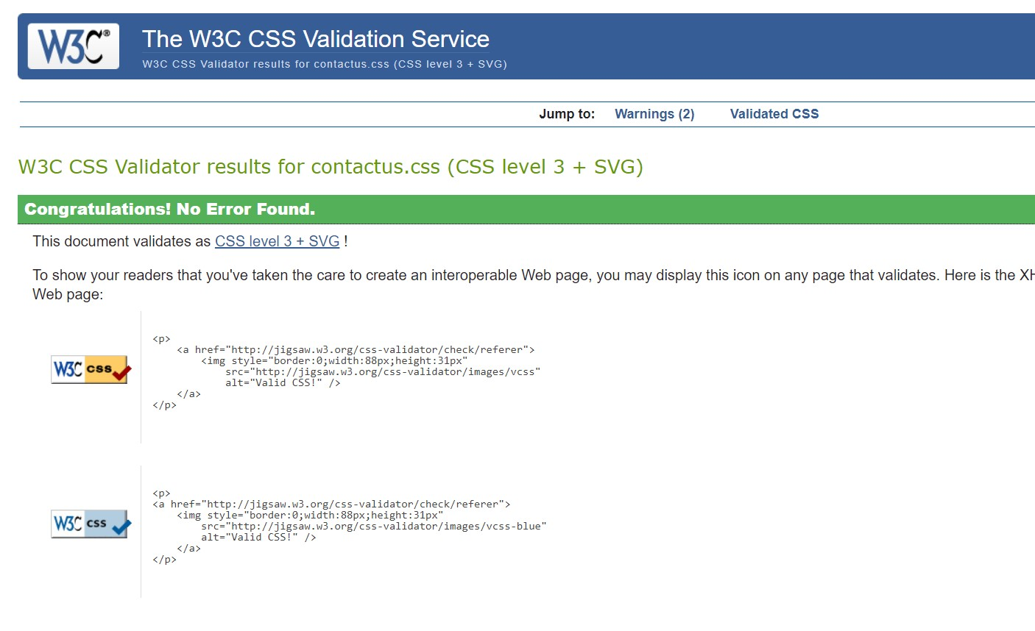
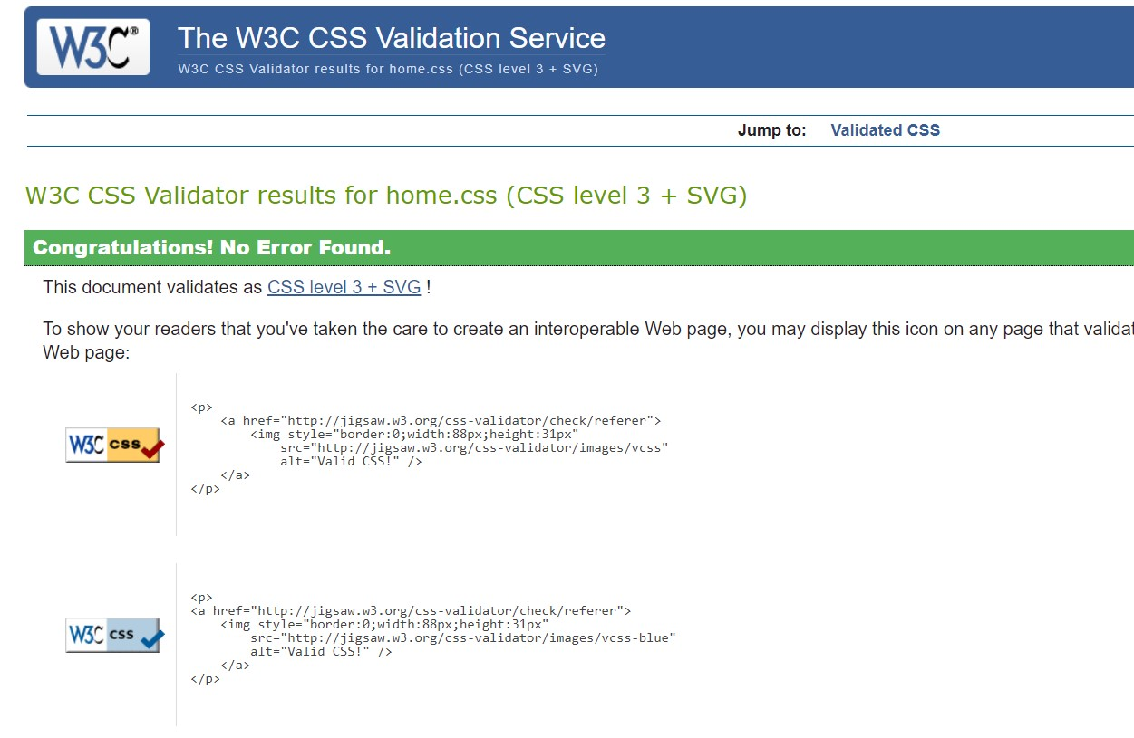
CSS Validation

Slide 12
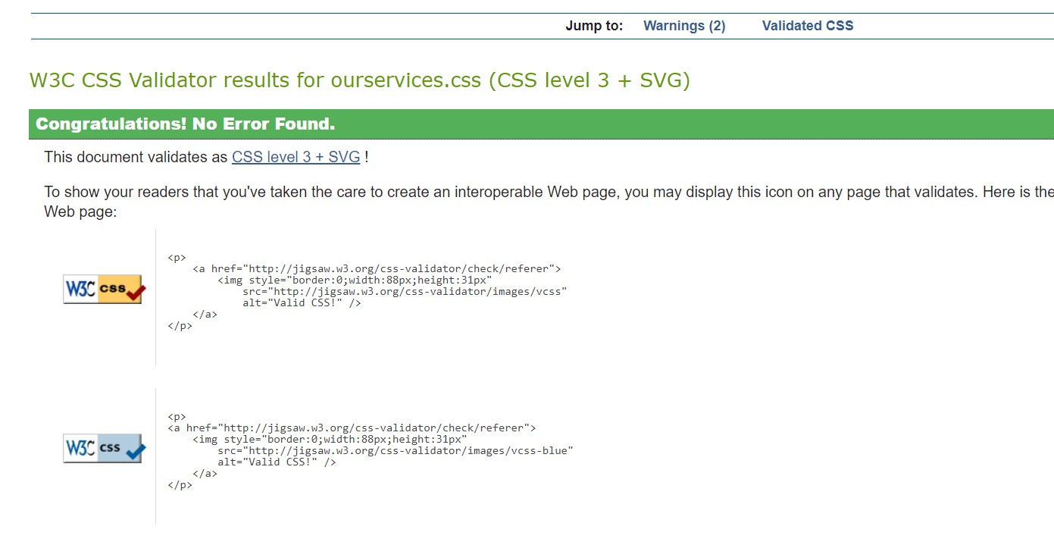
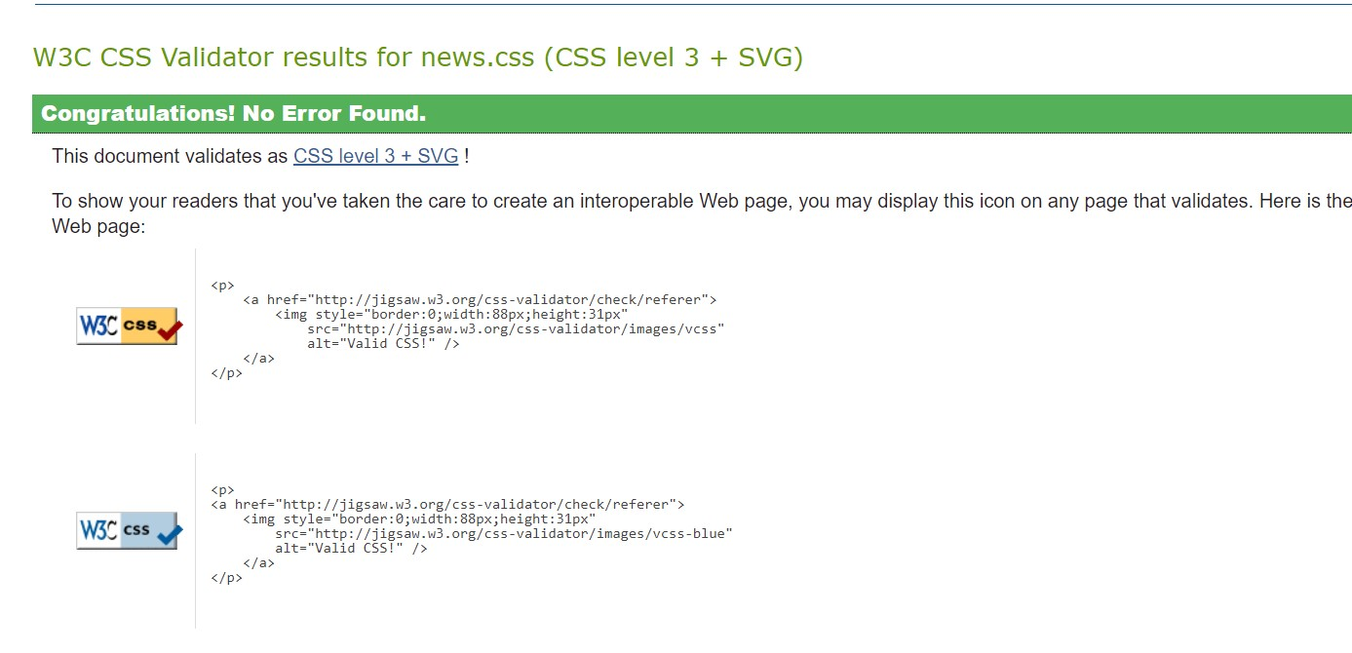
CSS Validation

Slide 13
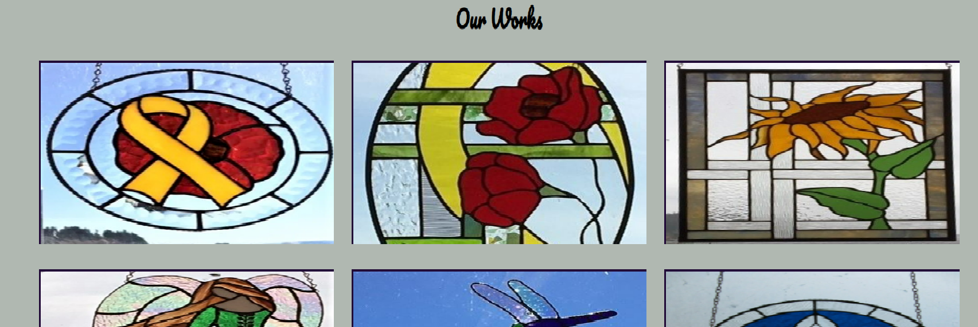
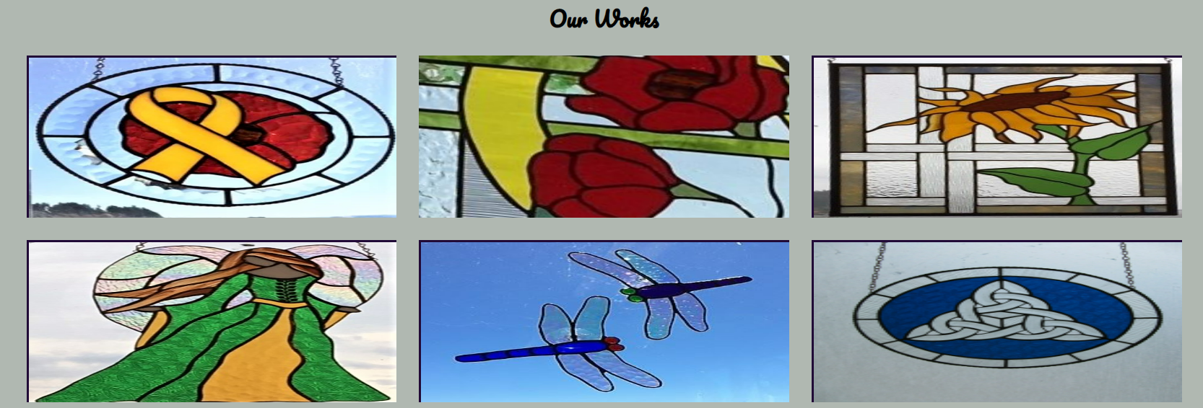
Proposal Implemented
On-Hover effect

Slide 14
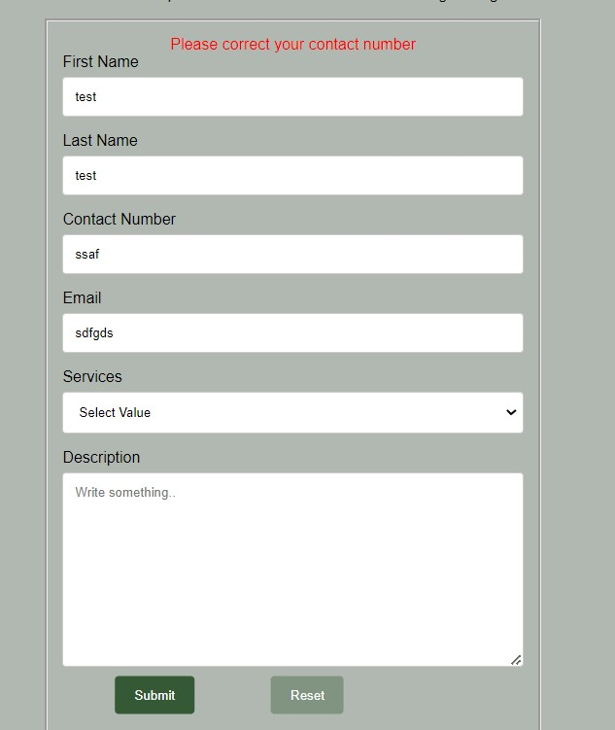
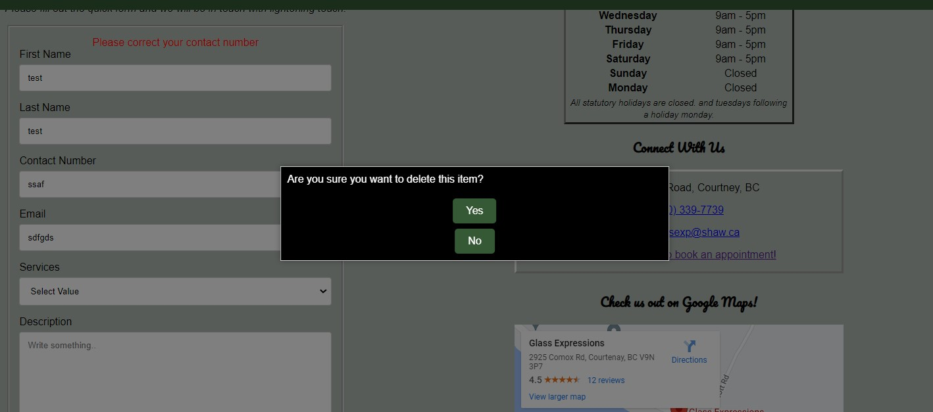
Proposal Implemented
Contact Us Page

Slide 15
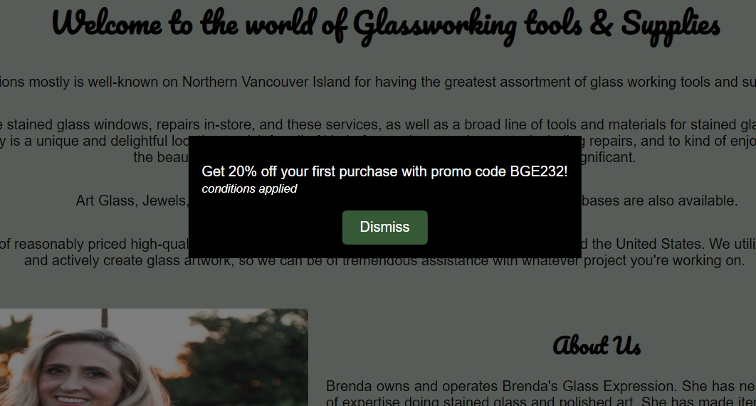
Proposal Implemented
Home Page

Slide 16
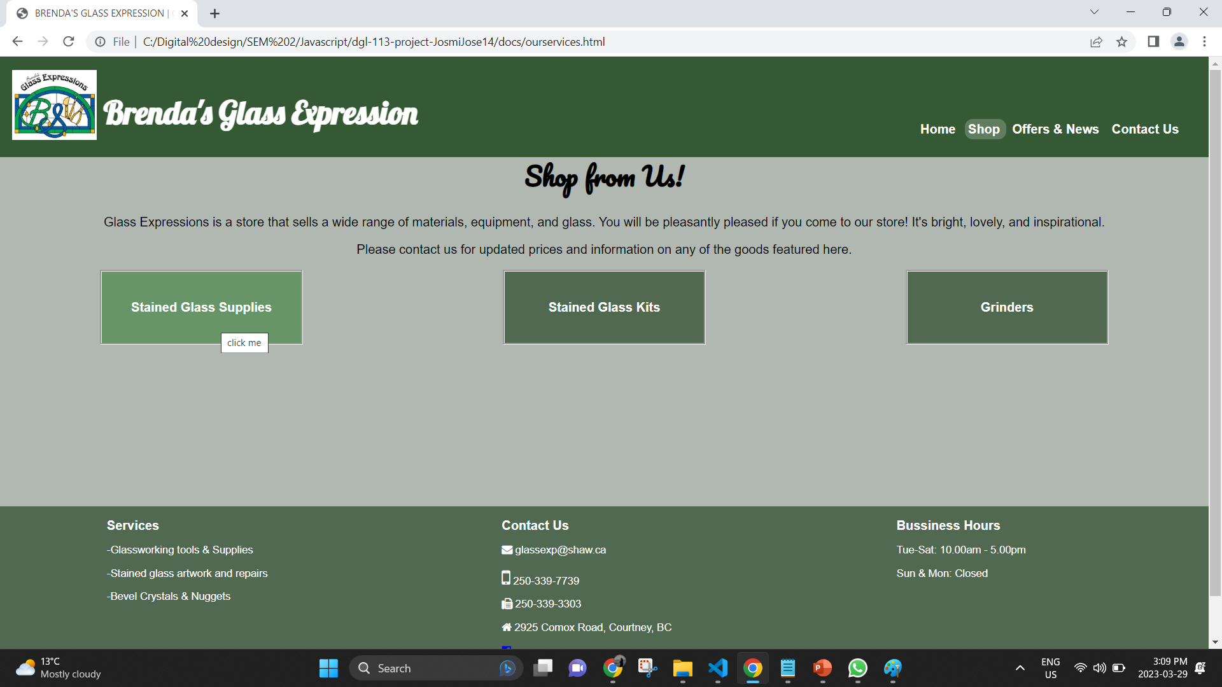
Proposal Implemented
Mouse enter Event

Slide 17
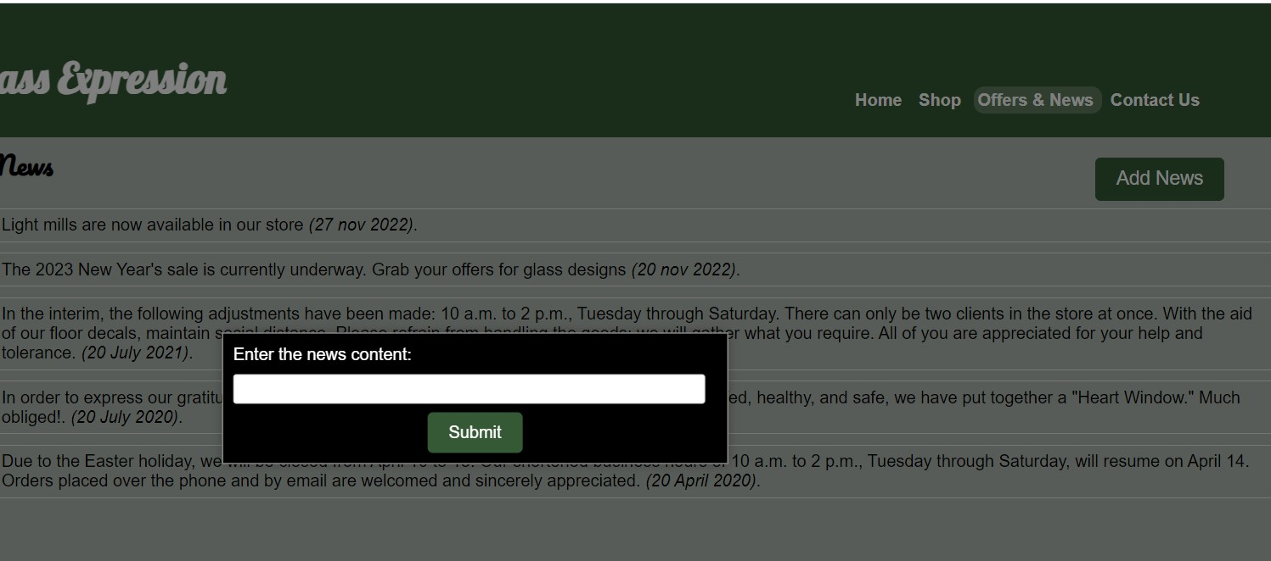
Proposal Implemented
Prompt

Slide 18
Link to repository
Project Repository

Slide 19

Thank you
Queries Please

